Slide 1

DatA and web mining
Application of data mining tools + Techniques CA
Dermot Madsen – 10522567
Ciaran Finnegan - 10524150
Wine Quality Dataset
Notes:
Intro –
Who we are and “this is a presentation on our CA…”
Fade into image..
..we choose to look at a dataset on wine quality and build a prediction categorical model.

Slide 2
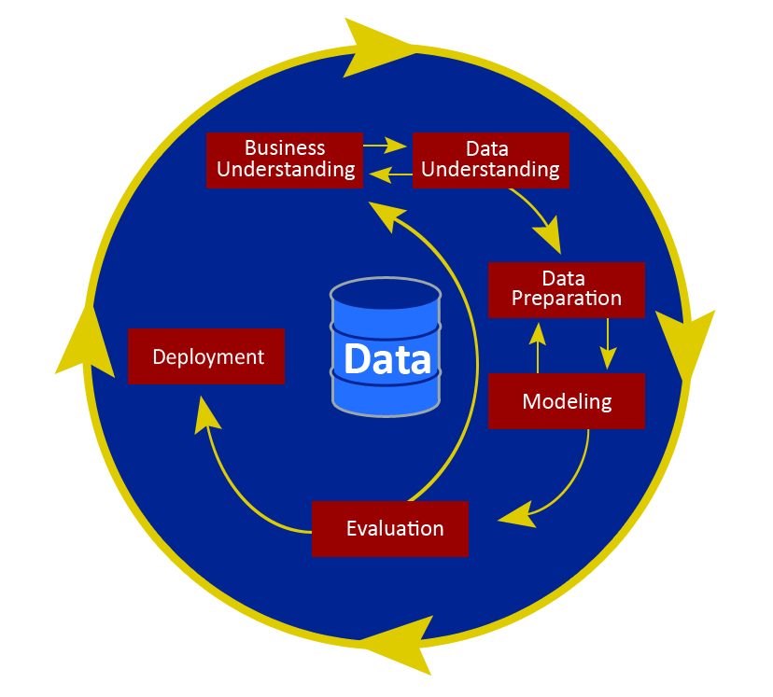
CRISP-DM
Notes:
Our project follows the CRISP-DM framework..
..this presentation is a slide by slide look at each of these steps.
As the diagram shows, there is a strong element of iteration and we’ll try and emphasise that as we go through the deck..

Slide 3
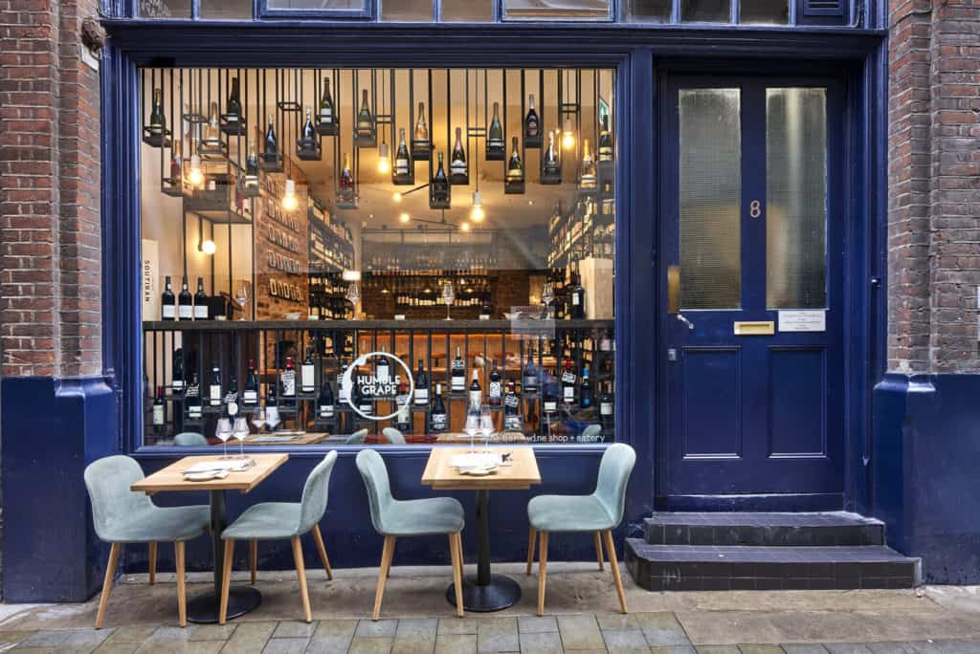
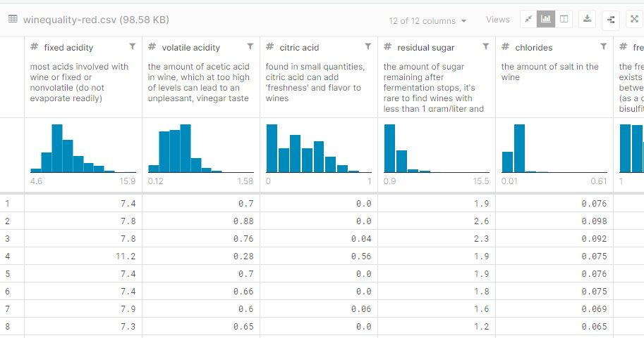

CRISP-DM : Business Understanding
Build a data driven predictive model to help staff recommend wine to customers.
Based on chemical data, not marketing or financial.
Notes:
So we did start by finding a dataset we liked and somewhat worked back into a business case…
...but Dermot and I put ourselves into business with a nice little wine shop/bar…
Fade into 1st text…our business logic is that we want to provide a.. <read text>
Fade into 2nd text…So we want to take our dataset of red wines and help employees appear a little more knowledgeable when recommending our speciality red (Portuguese) wine.
Fade into 3rd text…this is a chemical analysis, not being influenced by price or branding from wholesalers, market reviews, etc.

Slide 4
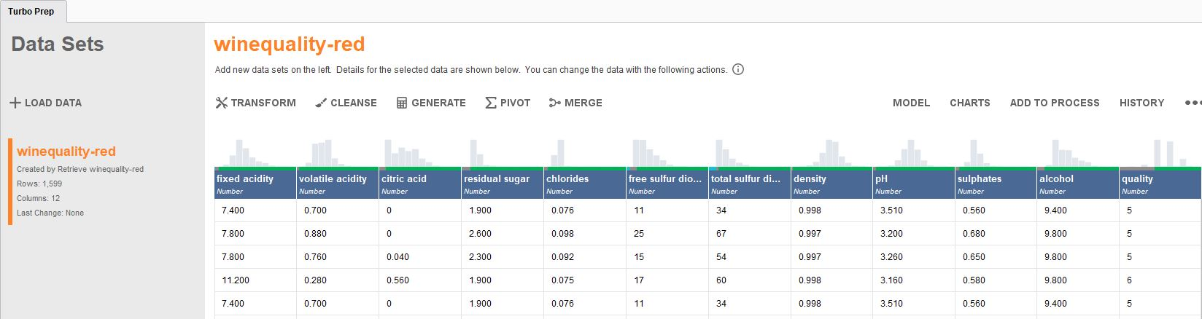
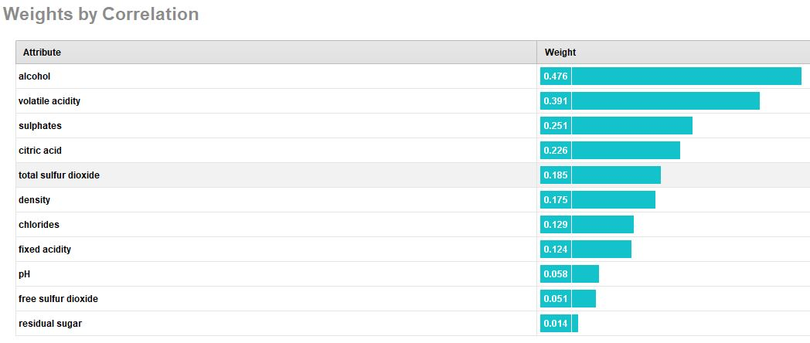
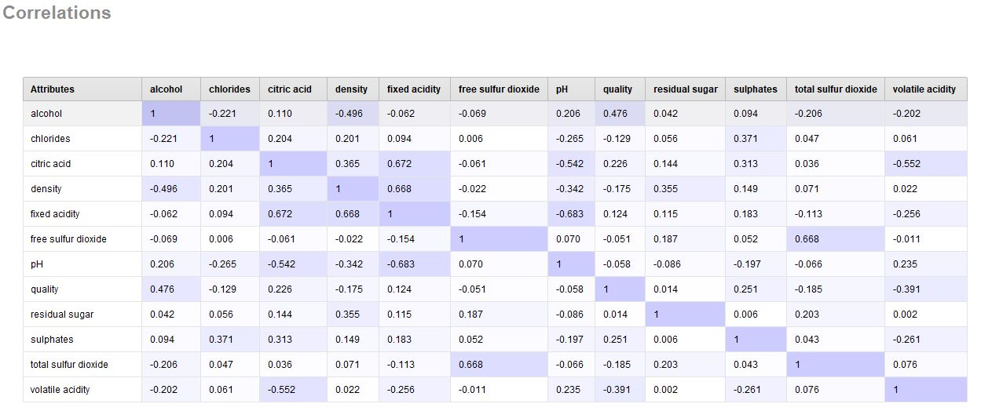
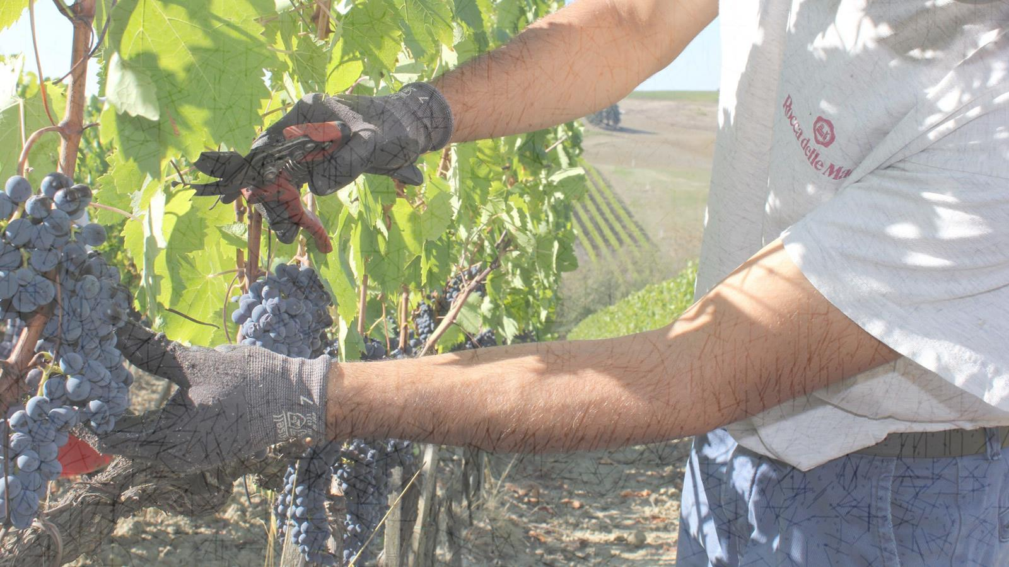
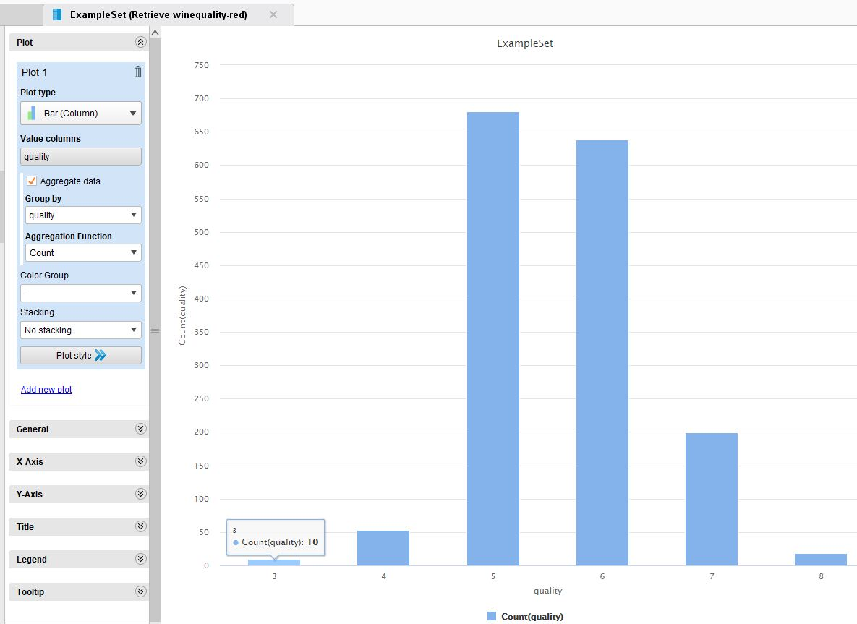
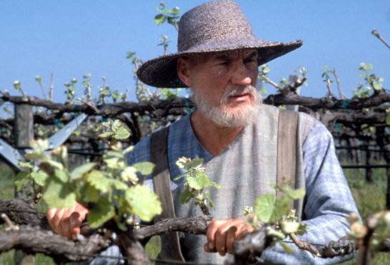
CRISP-DM : Data Understanding
Exploring the data – Kaggle Wine Quality dataset.
1600 rows x 12 columns.
‘Clean’ dataset – no missing rows, or ‘bad’ data.
Attributes vary in importance for ‘quality’.
Some correlation between features. Options to ‘prune’ feature list.
Dataset out of balance – few very poor or high quality wine entries.

Slide 5
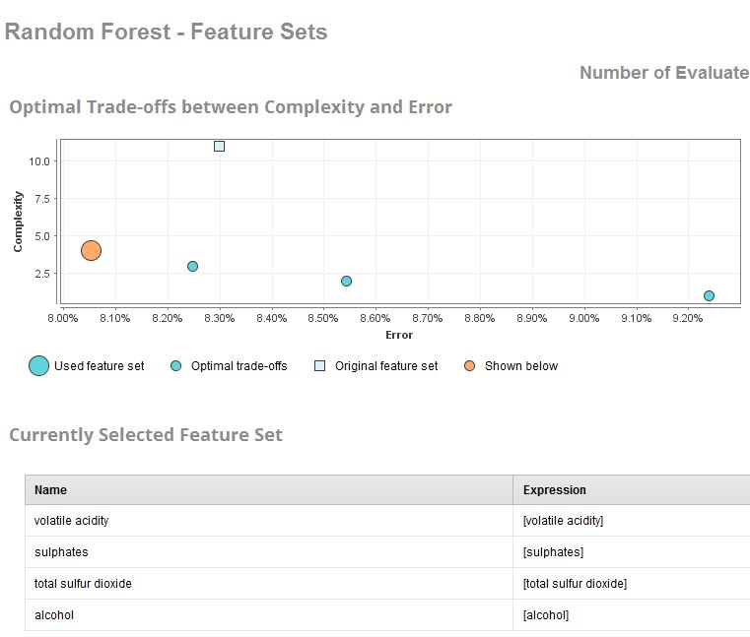
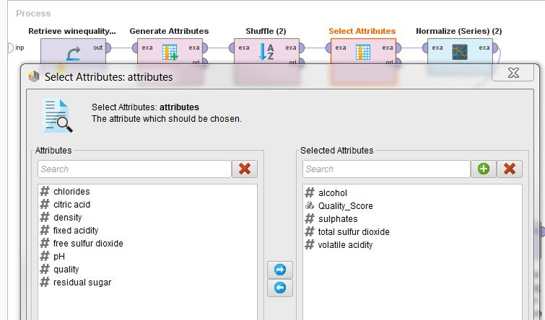

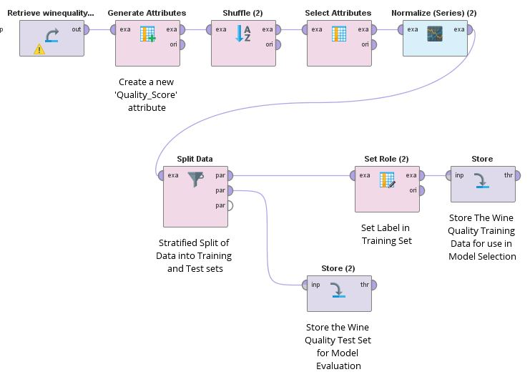
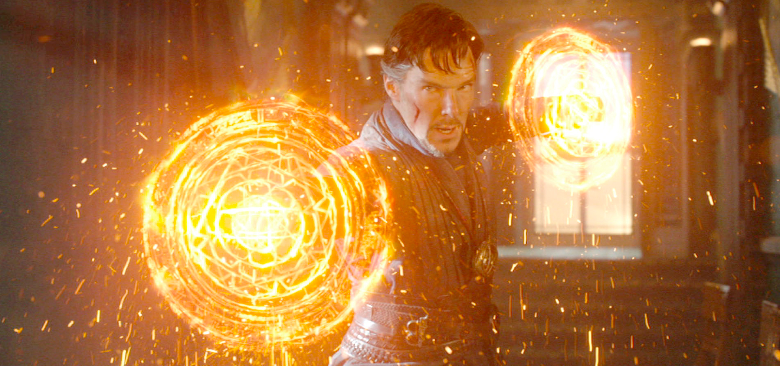
CRISP-DM : Data Preparation
All rows in the Wine Quality dataset were suitable for modelling.
RapidMiner AutoModel suggested a reduced feature set.
No ‘clean-up’ required.
Build a ‘Data Manipulation’ process in RapidMiner to also...
Create a new attribute to categorize the wine quality – Poor, Medium, High. Simplify the Classification.
Shuffle the data.
Normalize the attribute values – to prevent bias with certain columns
Store the transformed Training and Test data

Slide 6

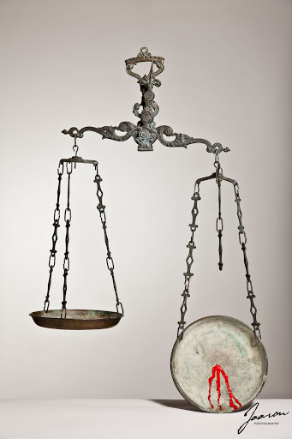
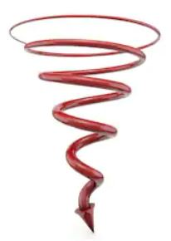
CRISP-DM : Data Preparation
The major challenge with the data was lack of balance across the wine quality categories.
Synthetic creation of new data
Options...
‘Down’ sampling of ‘real’ data
We used a combination of both.

Slide 7
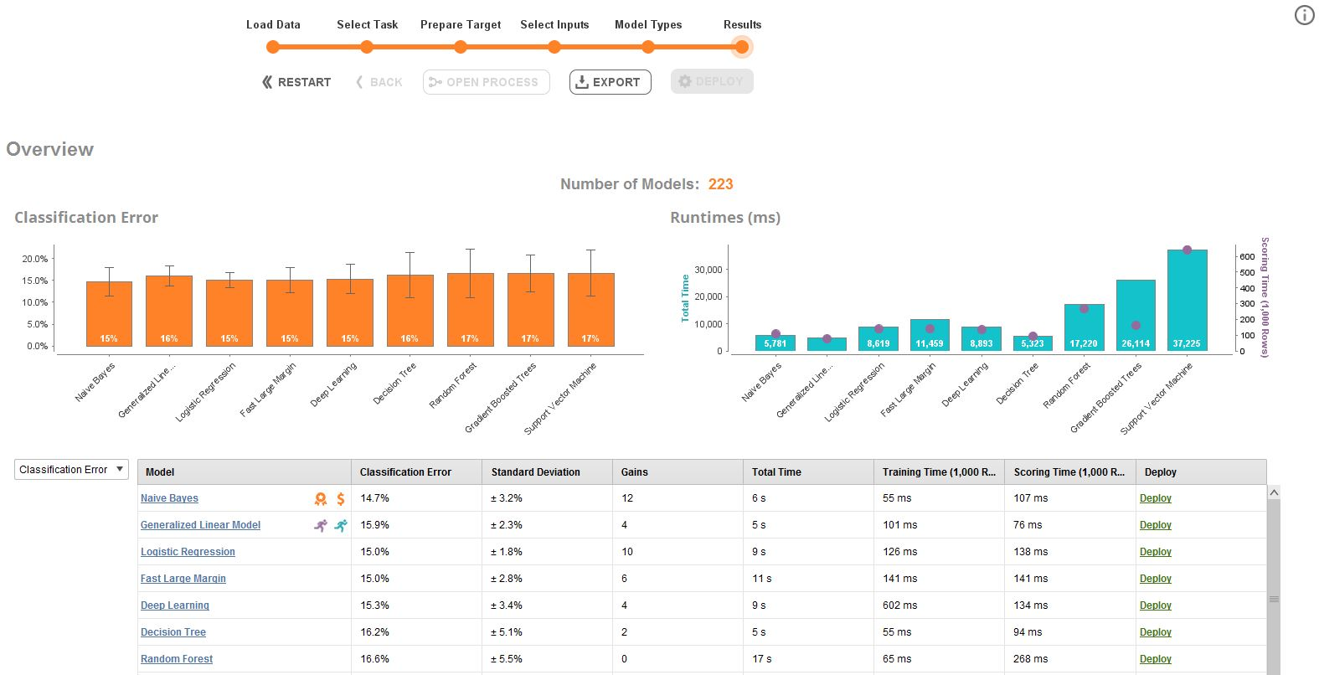
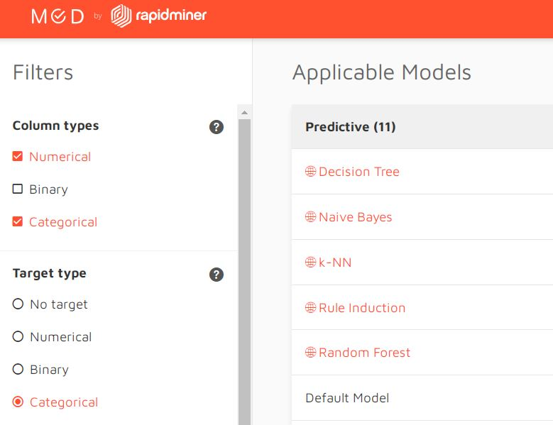
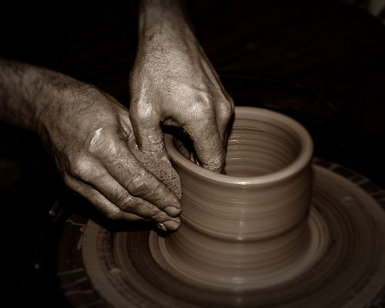
CRISP-DM : Modelling
Looked at RapidMiner AutoModel output but also at the RapidMiner utility for model selection.
Settled on 5 candidate algorithms...
Spent most time trying optimise model with Decision Trees, Random Forest and k-NN.
Notes:
First big question – what guidelines could we follow to select an actual algorithm and modelling technique?
Fade into 1st text…our first port of call was AutoModel with our Training Data..
Fade into 2nd text…then looking at the online application provided by RapidMiner
Fade into 3rd text…then..<read text>

Slide 8
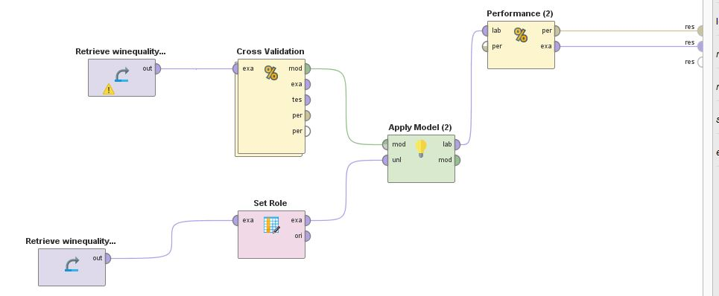
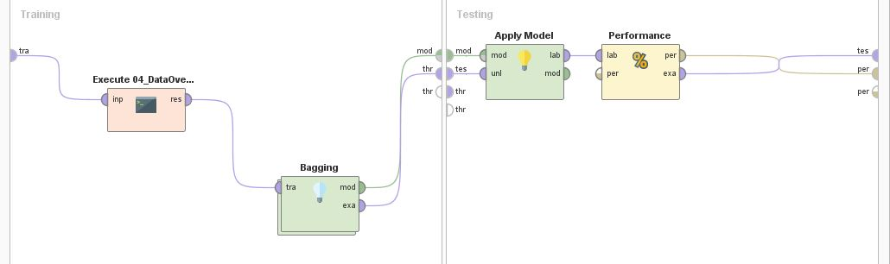
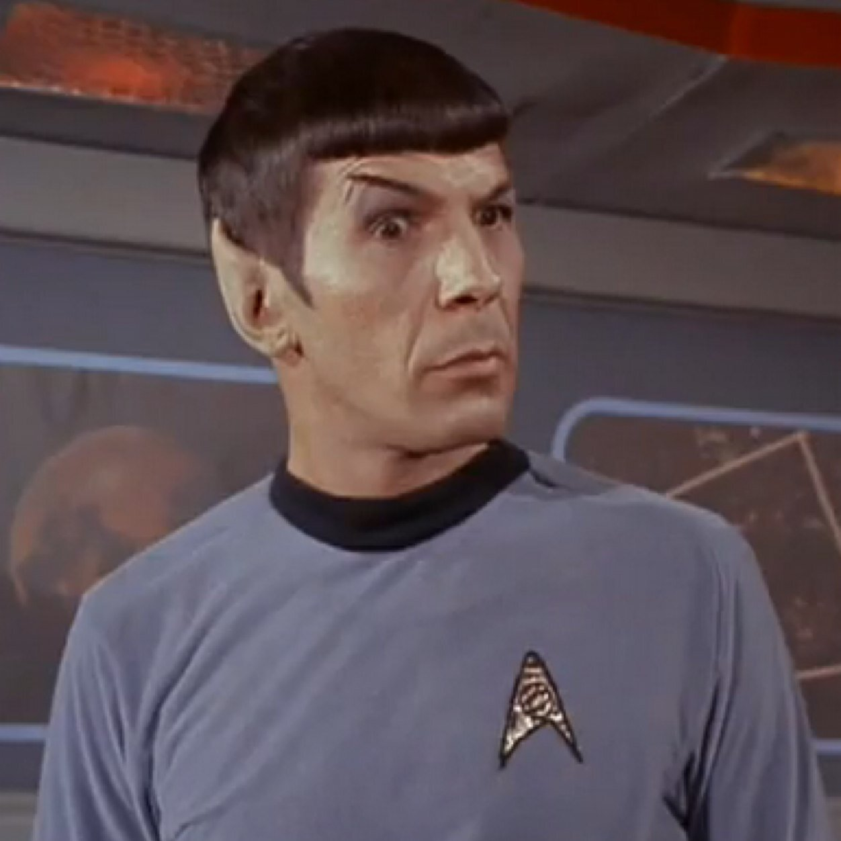
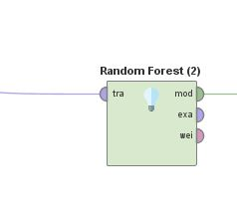
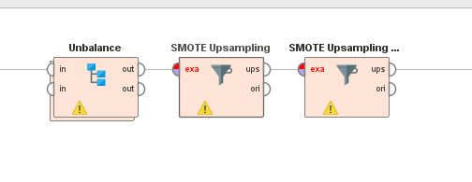
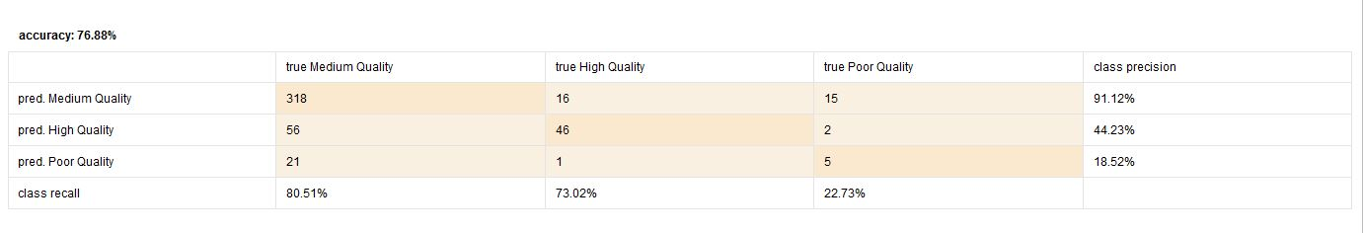
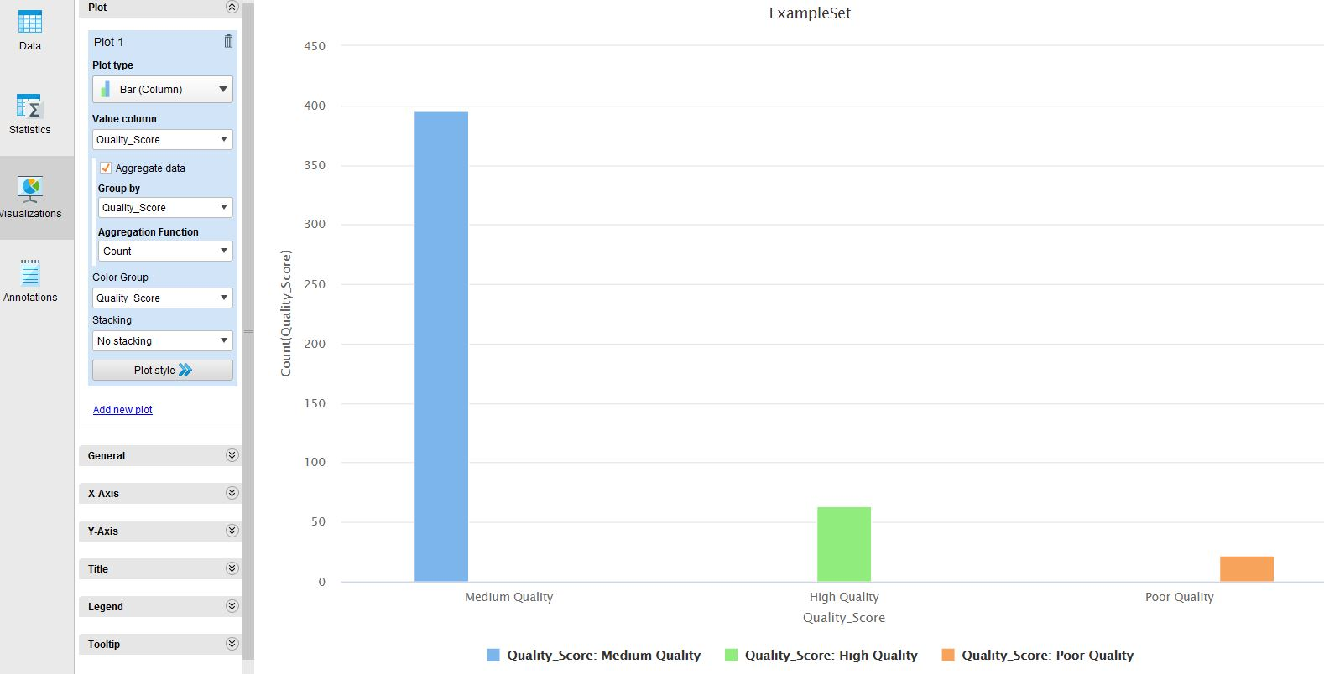
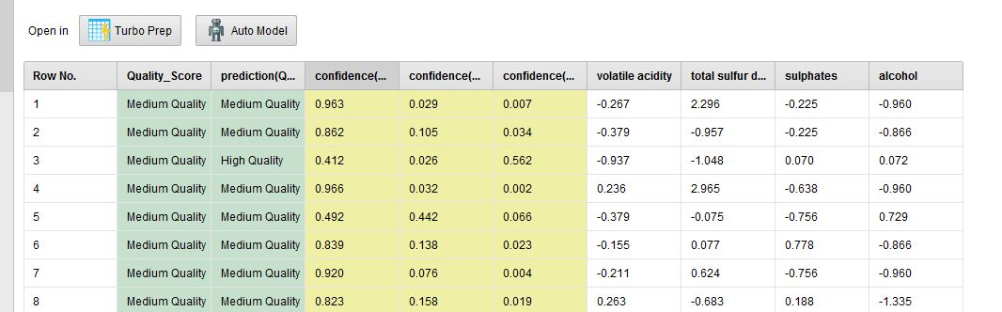
CRISP-DM : Modelling / Evaluation
Iterating through RM Processes and evaluating results.
Modelling
Evaluation
Notes:
So this phase involved many iterations..
Fade into 1st text…so it involved a lot of quizzical analysis of RM processes
Fade into model – explain pane by pane – “..this is the model we settle on..”
Fade into Modelling / Evaluation – repeated steps many time
Fade into evaluation panes – these are the type of results we were getting and trying to optimise.

Slide 9
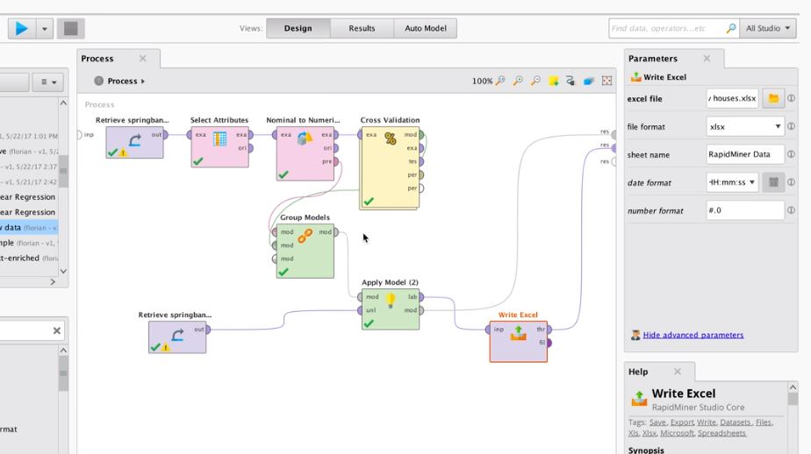
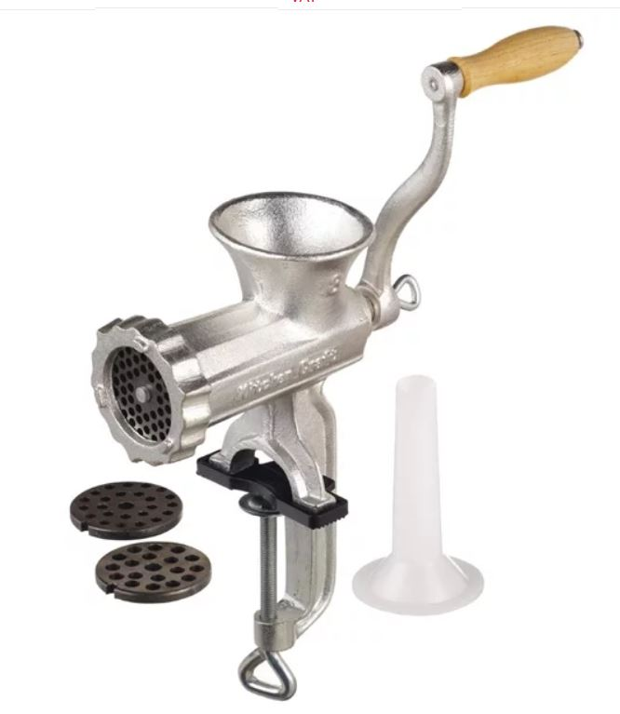
CRISP-DM : deployment
Read in new data to generate results in Excel ouput.

Slide 10
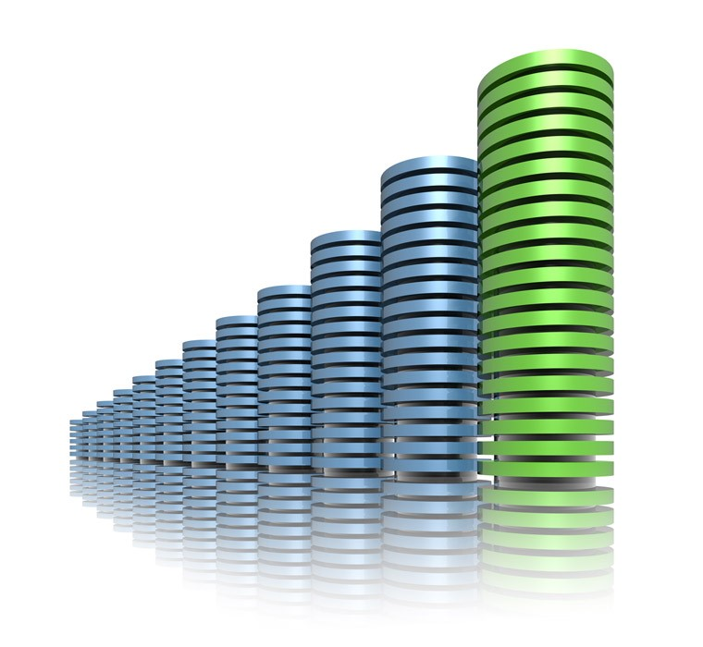
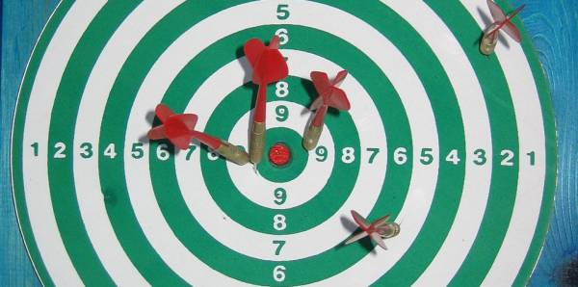

CA : Wine Quality Model : conclusion
The volume, balance, and nature of the data structure in the wine quality dataset made it difficult to build a useful model.
The business objective could be considered partially met in terms of acceptable accuracy with ‘Medium’ quality wines.
Perhaps a manual process could supplement the model for non-’Medium’ quality wines?

Slide 11

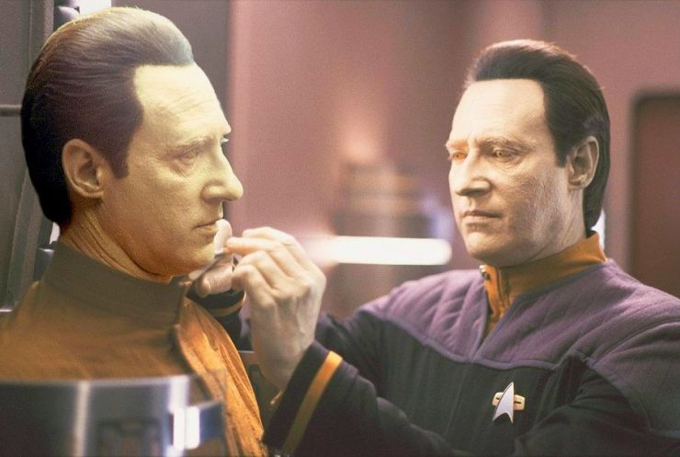
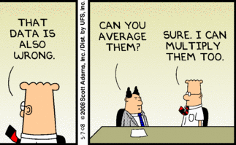
Learnings
The volume and quality of data is crucial.
Beware artificial data.
Models can be refined but cannot compensate for poor data.
Notes:
Read the text..

Slide 12
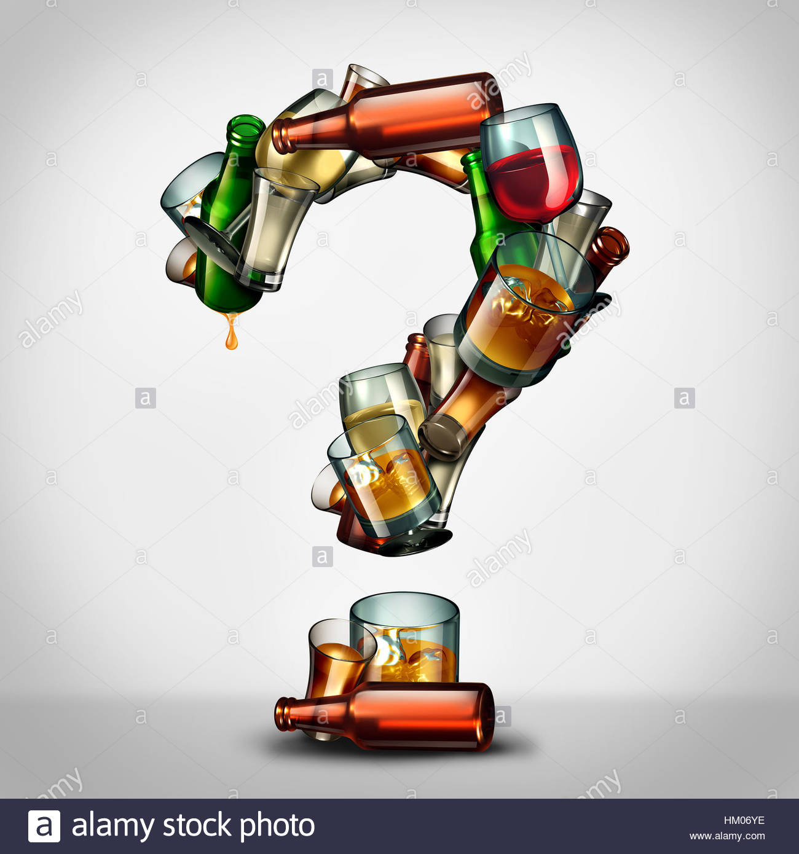
Notes:
Any questions…?

Slide 13


